Slide 1
Introduction to Consensus Decision Making
Via Community Development Workshop
By Laura Chatham
OKC MONTHLY COORDINATION MEETING
SEPTEMBER 2022
The SMARTer Growth Research Lab
Dr. Gordon Lovegrove | gord.lovegrove@ubc.ca
Faculty of Civil Engineering, UBC Okanagan

Slide 2
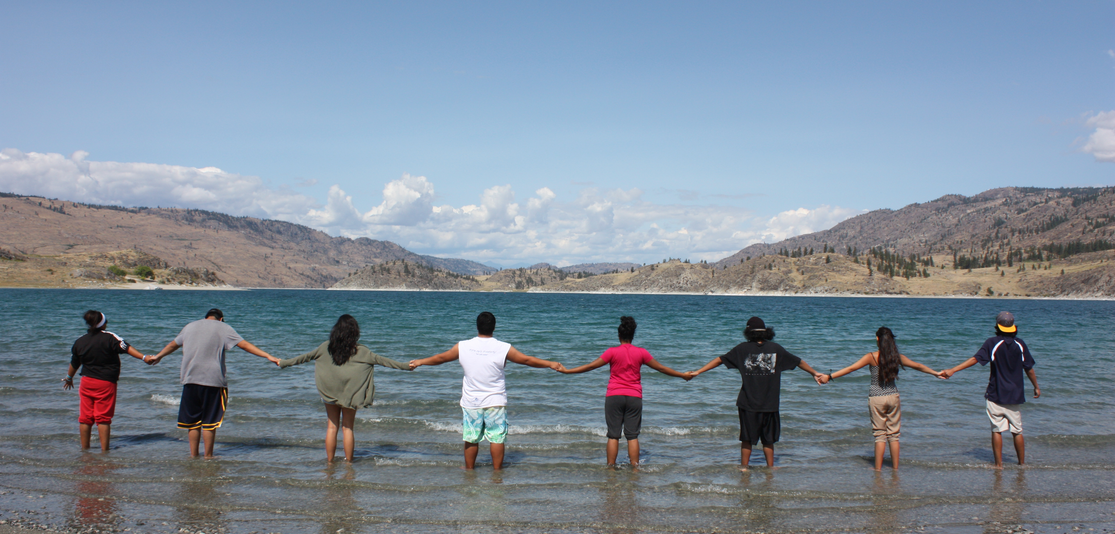
We were not here first
We acknowledge that Okanagan Cohousing aims to build housing on the unceded territory of the Syilx (Okanagan) Peoples.
We hope that by developing inclusive neighborhoods designed with resident participation to strengthening community connection, we can help bring all peoples of Canada together for the process of healing & reconciliation.
Learn more: https://www.syilx.org/about-us/syilx-nation/

Slide 3
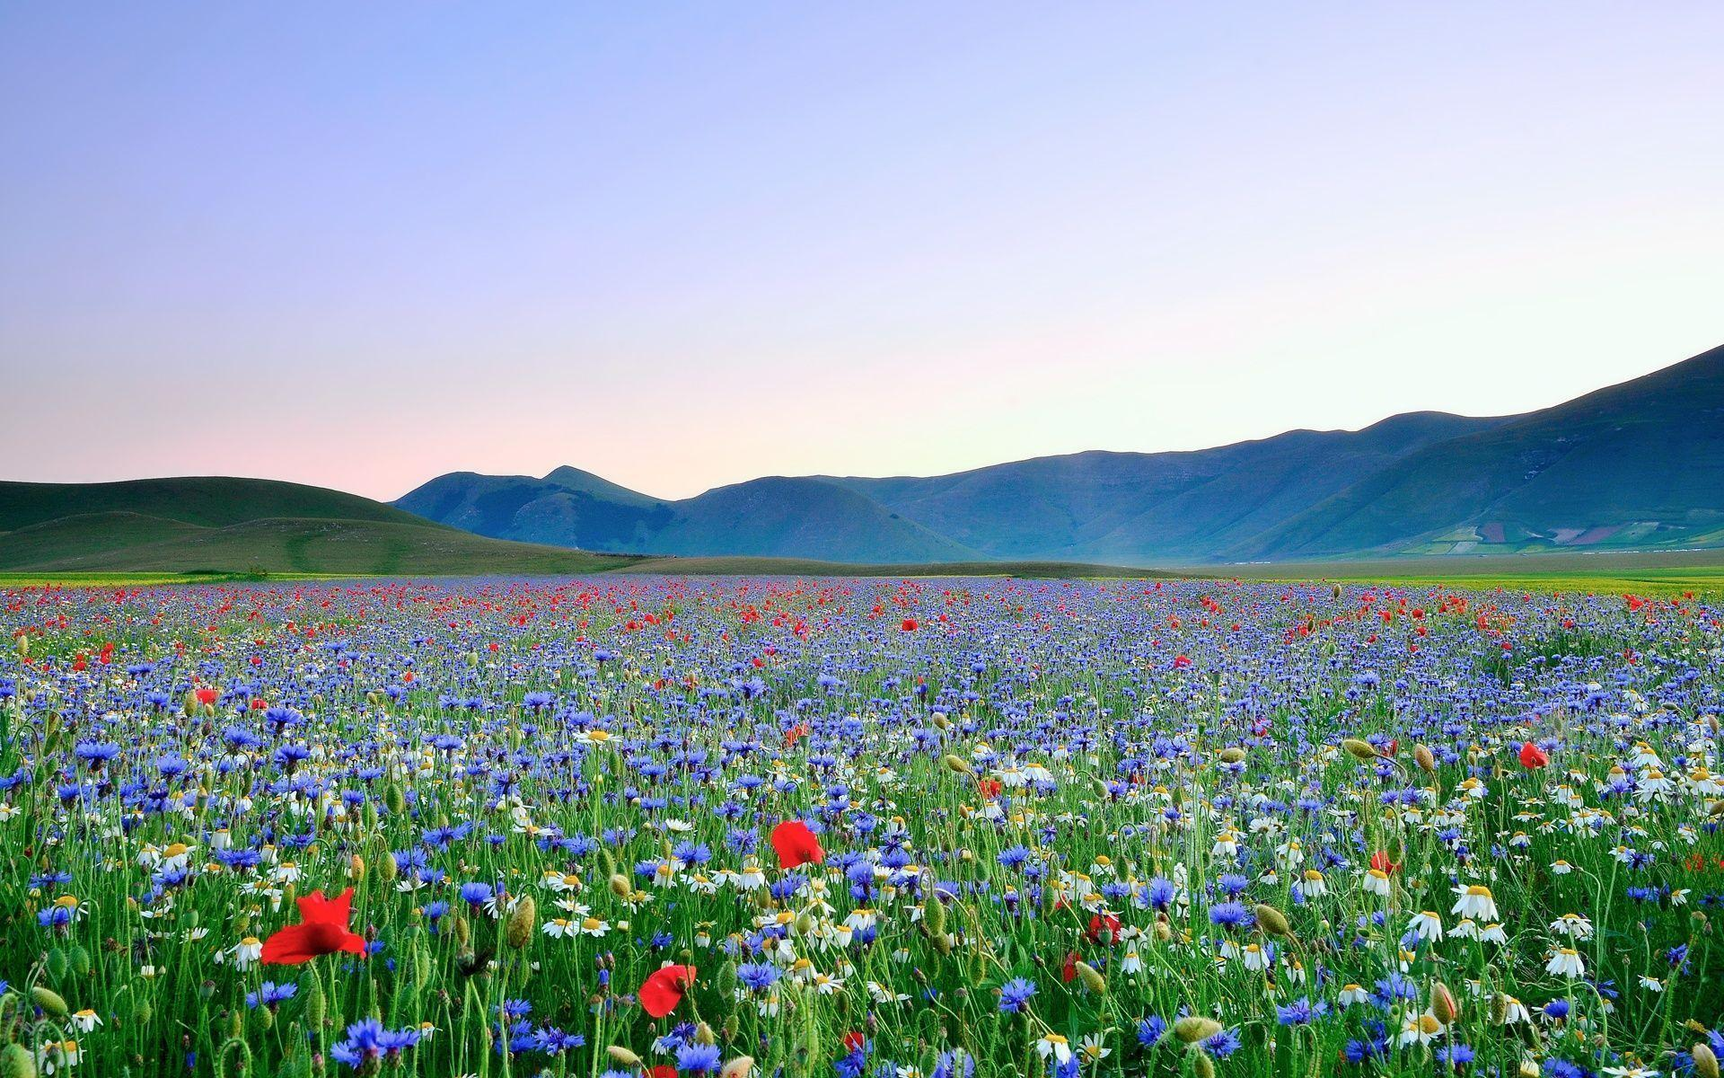
TABLE OF CONTENTS
Rational Decision Making
– Process, Styles
What Is Consensus Decision Making?
– Benefits, Cautions, Methods
Okanagan Cohousing CDM Workshop
– Community Group Updates
– Continue August Deliverables Worksheet
Notes:
• Design features decided will be DRAFTS until the whole of a community group agrees and a clear pathway of achievement is laid out

Slide 4
RATIONAL DECISION MAKING
SOMETIMES HARDER WITH OTHER OPINIONS
BUT FOR A MUCH BETTER DECISION…
safalniveshak.com
Notes:
• Part of daily life – when to wake up / what to have for breakfast / making a big life decision with multiple people to consider
• higher quality with multiple perspectives
• this guy would be much better off if he had a few friends telling him that's now hot to cut branches

Slide 5
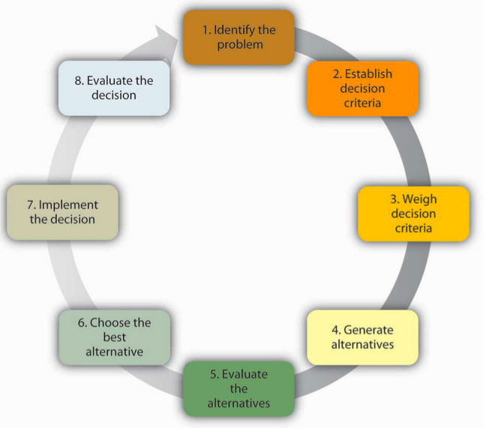
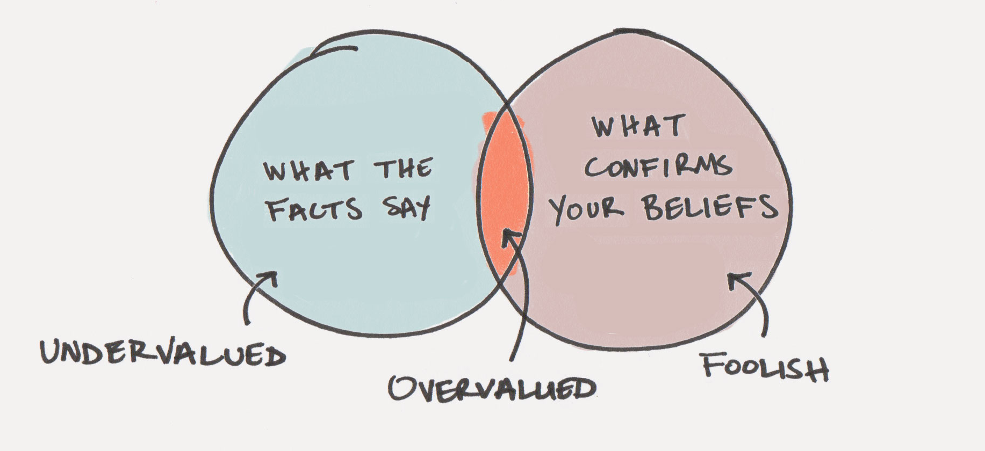
PROCESS OF RATIONAL DECISION
BE AWARE:
CONFIRMATION BIAS
University of Minnesota
Notes:
• (right)
• (left) – be aware of your biases, we all have them. Being good at making any decisions, especially collaborative ones, takes a lot of self awareness and discipline.

Slide 6
6 STYLES
OF DECIDING
1 – (leader) Top-down
2 – (leader) Opinions After
3 – (leader) Opinions Prior
4 – (group) Majority
5 – (group) Consensus
6 – (other) Delegation
Managing w Mind & Heart Podcast #35 | The Great
Notes:
• The Great – 18th Century. Cathrine marries Emperor and has a dream to help Russia become more civilized (w/ democracy & equality), but emperor is a spoiled ass and Russia is all about guns & glory, and authoritarianism rule – hilarious satire of politics and power balance
• study by Google – what makes a perfect team? Found it is a team with multiple decision styles which is highest performing

Slide 7
STYLE 5 – CONSENSUS
PROCESS WHERE ALL GROUP MEMBERS COLLABORATIVELY AGREE ON A DECISION TOWARDS A COMMON GOAL
TIPS:
• Know Yourself
• Build a Safe Environment
• Be Open & Creative
• Learn to Disagree
Notes:
Process in which ALL GROUP MEMBERS – COLLABORATIVELY develop & AGREE TO SUPORT a decision in the best interest of a COMMON GOAL
• why we'll be revisiting the goals & visions done previously.

Slide 8
BENEFITS
Greater Support of Decision
Increased Perspective
• Accountability
Team Building
Notes:
perspective – higher quality

Slide 9
CAUTIONARY TALES
• Time Management
• Circular Arguments
• Fear of Taking Charge
• Fear of Creative Risk
Notes:
• time – discussion, processing
• circular – w/o some people taking charge (aware not always same person)
• creative risk – goes back to safe group environment
Larger groups also gets more difficult

Slide 10
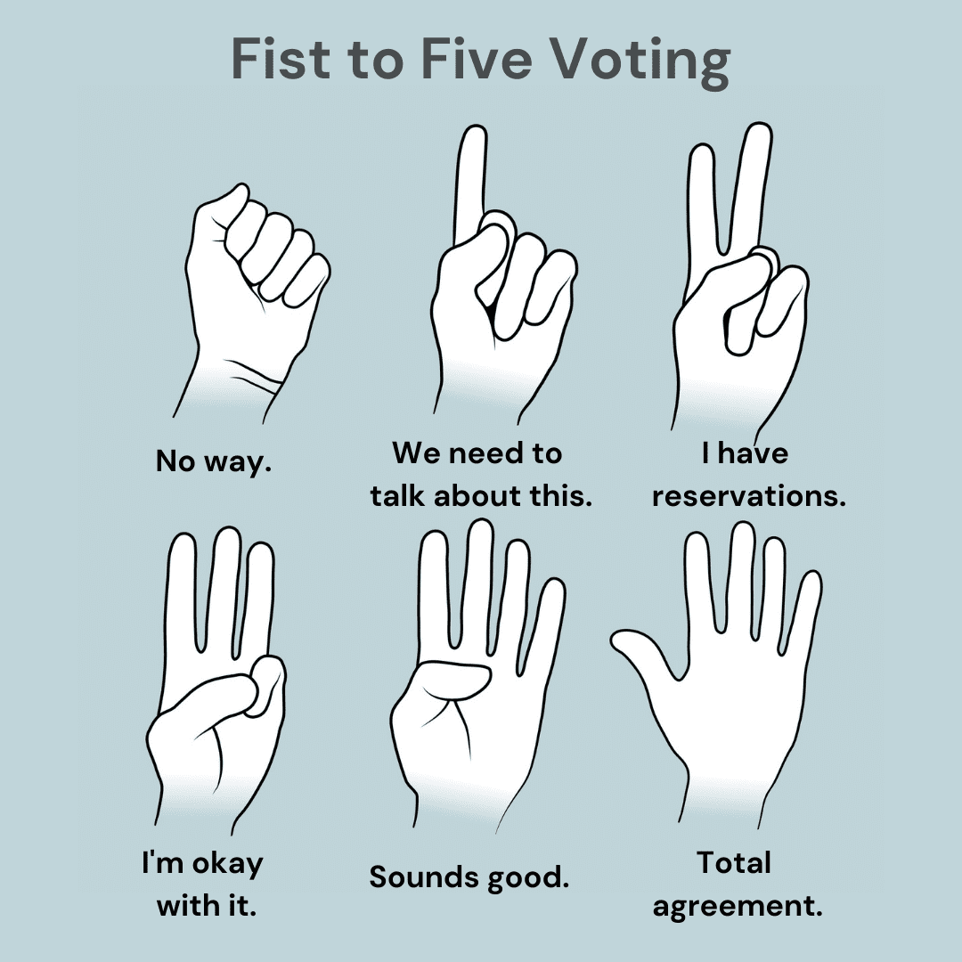
CC
METHODS OF CONSENSUS
Disagree | Collaborate | Commit
• Identify Problem
• Brainstorm – creative flow
• Evaluate Ideas – give time
• Make Decision
Notes:
Being able to disagree is a sign of maturity – scale of agreement
5 – 100%
4 – I like it, but not quite as excited about it
3 – ok, I have concerns but I'll support
2 – I’m struggling a bit with it but won’t block it
1 – I don't like it, but won't block it
0 – will block it

Slide 11
(1)
(1) State Problem
(2) Brainstorm
(3) Evaluate Ideas
(4) Make Decision
(4)
(2)
(3)
University of Minnesota
Notes:
• (right)
• (left) – be aware of your biases, we all have them. Being good at making any decisions, especially collaborative ones, takes a lot of self awareness and discipline.

Slide 12
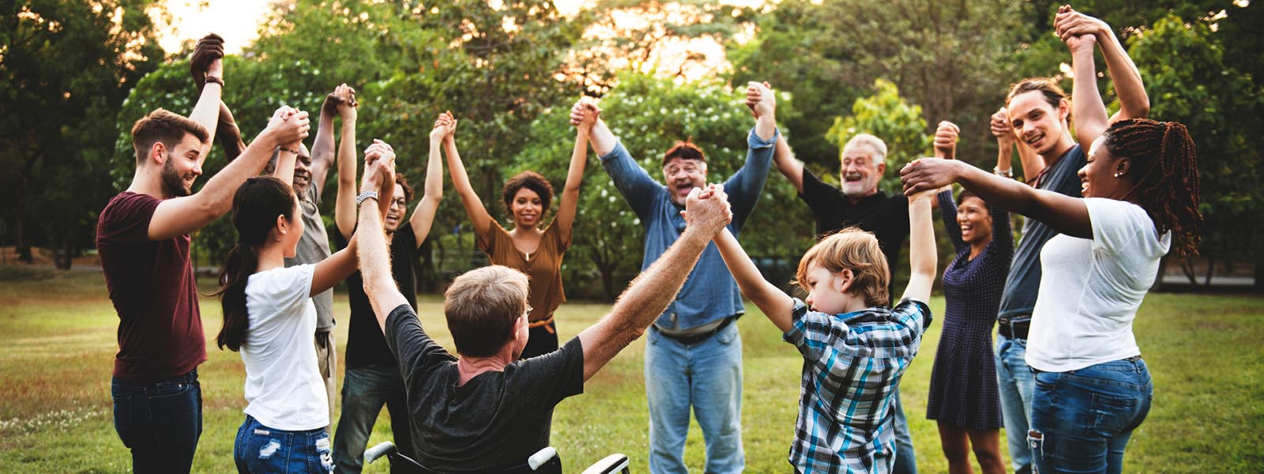
CDM Workshop
COMMUNITY DEVELOPMENT
Notes:
For both parts, groups start with community team for ~30 minutes, then do 10 minute group shuffles to vary perspective
• List of tasks shows what we’re aiming towards; it’s ok if groups don’t complete them so long as they’re practicing consensus decision making

Slide 13
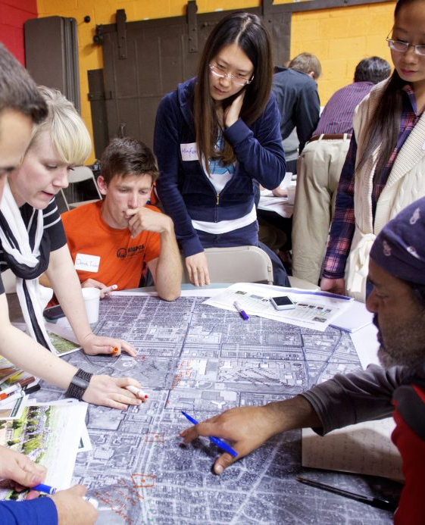
COMMUNITY DEVELOPMENT
1hr via Zoom
• 15 min – Progress update from ea/ Group
– Confirm member lists
• 30 min – Breakout Rooms to work on
August Deliverables Worksheet
• 15 min – Debrief; Upcoming Events

Slide 14
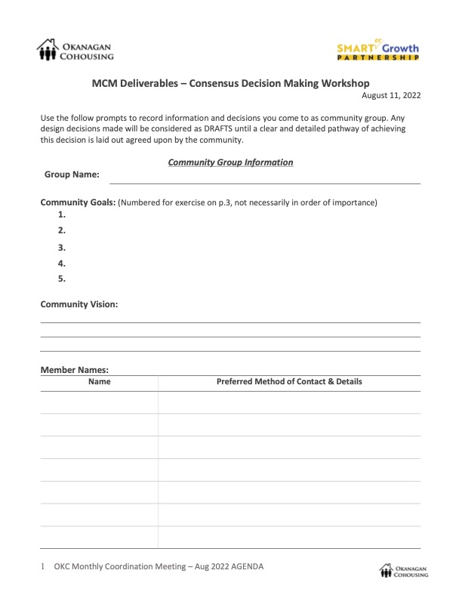
Workshop Deliverables
( A )
By the end of the night, each community group should have as DRAFTS:
A (placeholder) Community Name
All Members’ Names & Method of Contact (present & not)
Communication Channels & Meeting Time
Community Goals & Vision

Slide 15
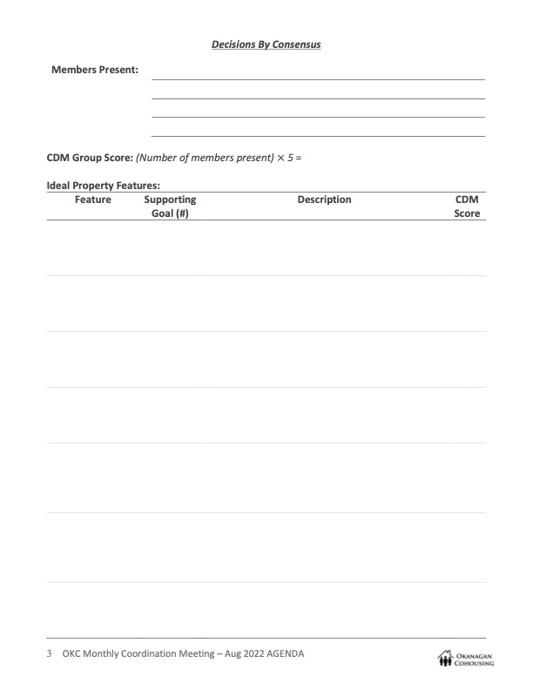
Workshop Deliverables
( B )
If finished Deliverables (A), continue onto physical design aspects (DRAFTS):
Property size, terrain, utilities…etc
Common Facilities
Number & type of units
Nearby Amenities
Housing Styles

Slide 16
RESOURCES
COHOUSING
• The Canadian Cohousing Network – https://cohousing.ca/
• CohoUS – https://cohousing.org/
• Creating Cohousing by McCamant & Durrett – https://newsociety.ca
CONSENSUS DECISION MAKING
• Consensus Home – https://www.consensusdecisionmaking.org/
• Seeds For Change – https://www.seedsforchange.org.uk/
• Managing with Heard & Mind Podcast #35 – https://open.spotify.com
CONTACT US: gord.lovegrove@ubc.ca (Principal Investigator)| laura.chatham@ubc.ca (Lead Researcher)
VISIT US: https://sustainablecommunities.ok.ubc.ca/research/cohousing/

